Slide 1
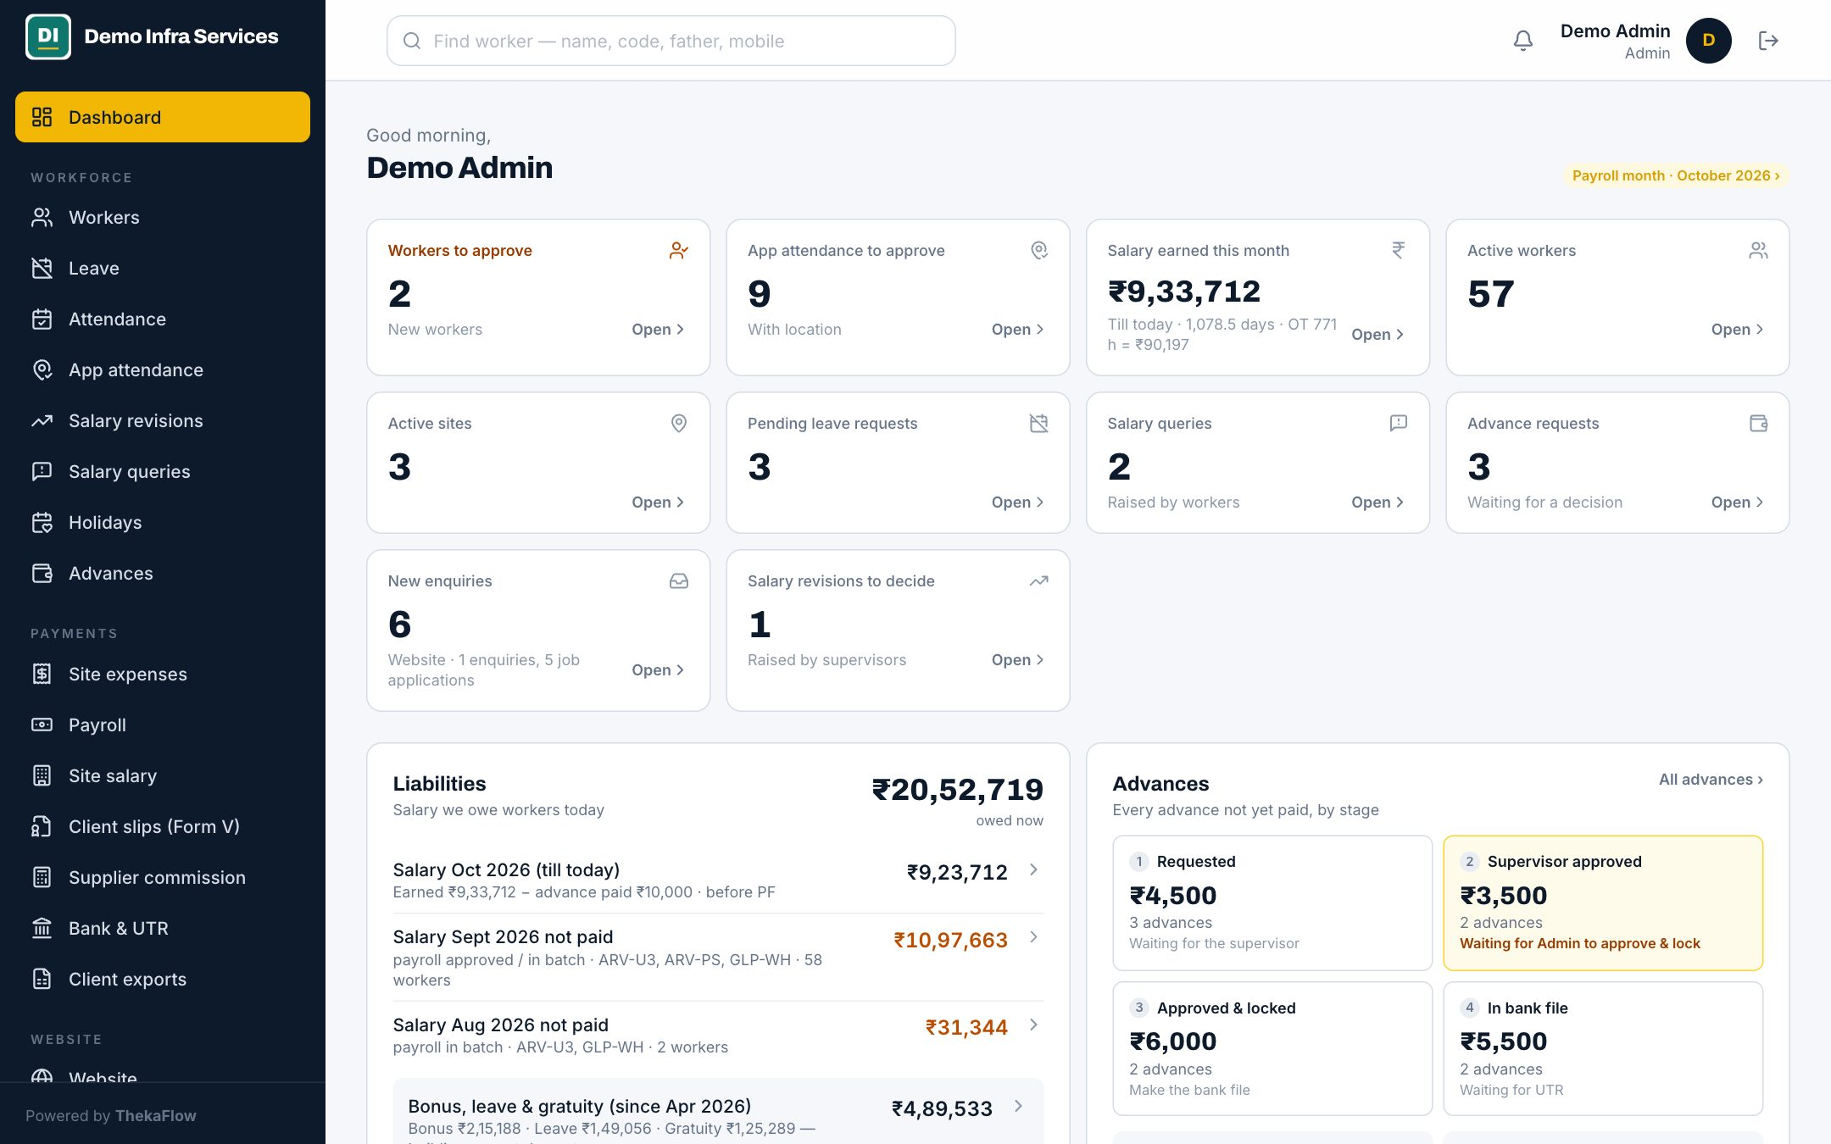
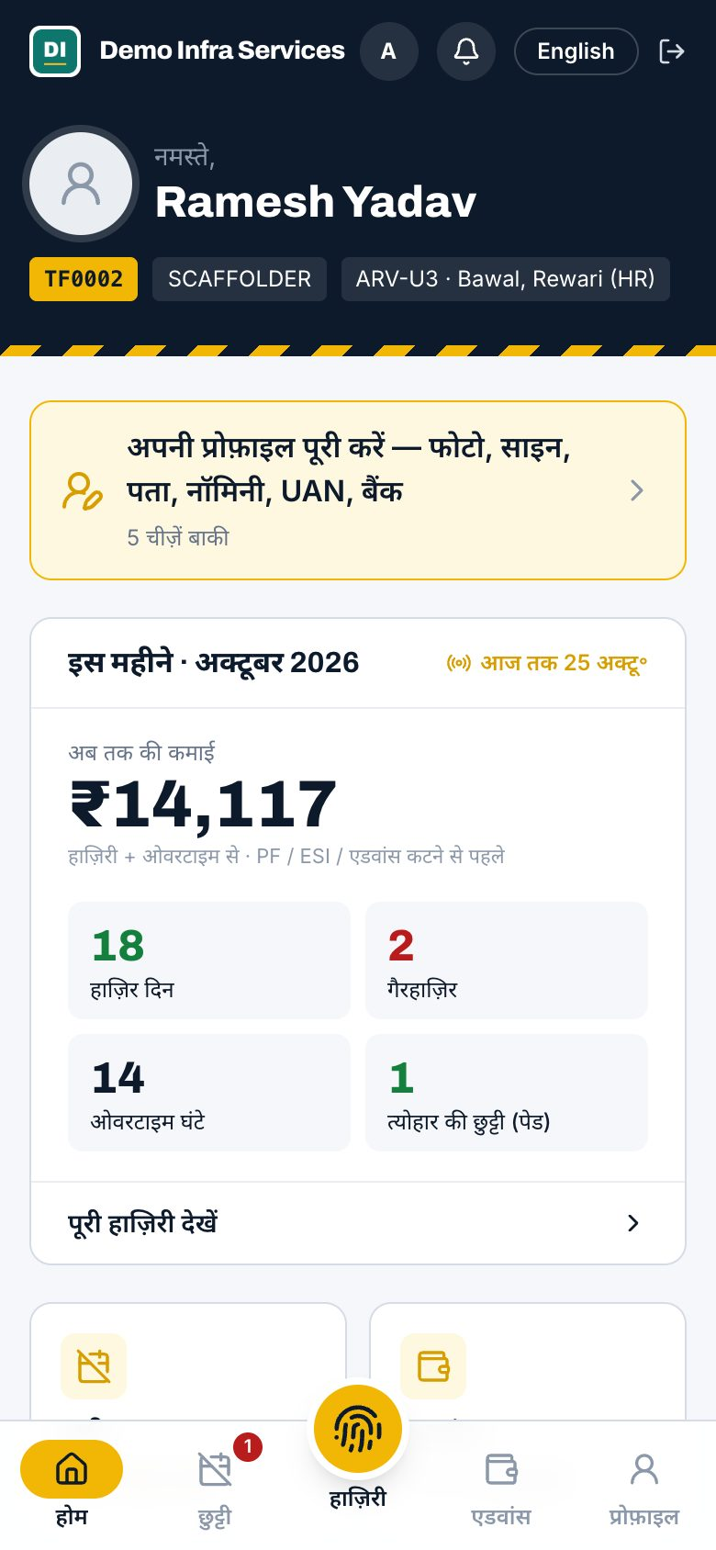
ThekaFlow
PREPARED FOR [CLIENT COMPANY]
Attendance, payroll, payments and compliance for contract-labour contractors
Hazri se bank file tak — ek system.
Notes:
Namaste. Aaj 20 minute me dikhayenge ki aapka poora mahina — hazri se lekar salary, bank file, UTR aur client ke Form V tak — ek system me kaise chalta hai. Pehle samjhenge aap abhi kaise kaam karte hain, phir har module screen ke saath. [Client company] ki jagah unka naam daal dein.

Slide 2
Your month today
Mahine ka end, aur kaam ka pahaad
01
Salary takes days
Matching hazri, OT, half days and advances by hand at month-end.
02
Bank portal, one by one
Every worker typed into the bank site, then hunting for each UTR.
03
Client audits
Form V and the wage register rebuilt in a new Excel every month.
04
Advances on paper
Who took how much, and how much is still to recover?
05
“Meri salary kam aayi”
No slip, no record — and the argument starts at the site.
ThekaFlow · thekaflow.com
2
Notes:
Yahan client se poochiye: abhi salary banane me kitne din lagte hain? Bank me entry kaun karta hai? Client har mahine kya maangta hai? Unke jawab note kariye — demo usi order me dikhana hai.

Slide 3

One flow, every month
Hazri se bank file tak — ek system
1
2
3
4
Hazri
Payroll
Bank file
UTR and slips
Supervisor fills the sheet, or workers mark attendance in the app with GPS.
Wages, OT, PF / ESI and advance recovery are calculated. Admin approves.
One click makes the bulk file in your bank’s format — salary and advances.
Upload the bank’s report: UTRs attach, slips reach workers’ phones.
Every step leaves a record — who did it, when, and why. Client compliance (Form V, wage annexure) is built from the same data.
ThekaFlow · thekaflow.com
3
Notes:
Ye poore system ka saar hai. Chaar kadam, har mahine. Aage har kadam ki screen dikhayenge.

Slide 4





Everyone gets their own login
Har kisi ko utna hi, jitna uska kaam
Admin / owner
Supervisor
Finance / CA
Worker
Supplier (thekedar)
Approves workers, payroll and advances, makes bank files, sees every site and every rupee.
Fills attendance for own sites, approves app attendance and advances, keeps the site fund.
Payroll, bank files, UTR, PF / ESI and client reports — without touching attendance.
Hindi or English app: attendance with GPS, earnings, slips, advance and leave.
Own workers, their attendance and the commission for the month.
ThekaFlow · thekaflow.com
4
Notes:
Paanch tarah ke log, paanch alag login. Supervisor sirf apni sites dekhta hai. CA ko attendance chhune ki zaroorat nahi. Worker aur thekedar Hindi me dekh sakte hain.

Slide 5
Every site, every rupee, one screen
DASHBOARD
Subah khola, sab saamne
Needs attention: approvals waiting, sheets not filled
Salary owed to workers today, advances to recover
Today’s attendance by site, workers on leave
Gate passes expired or expiring in 30 days
Quick actions, and approval alerts on your phone
ThekaFlow · thekaflow.com
5
Notes:
Owner ke liye sabse kaam ki screen. Kya pending hai, workers ka kitna paisa baaki hai, kitna advance wapas aana hai — sab ek nazar me. Supervisor ko yahi screen sirf apni sites ke saath dikhti hai.

Slide 6
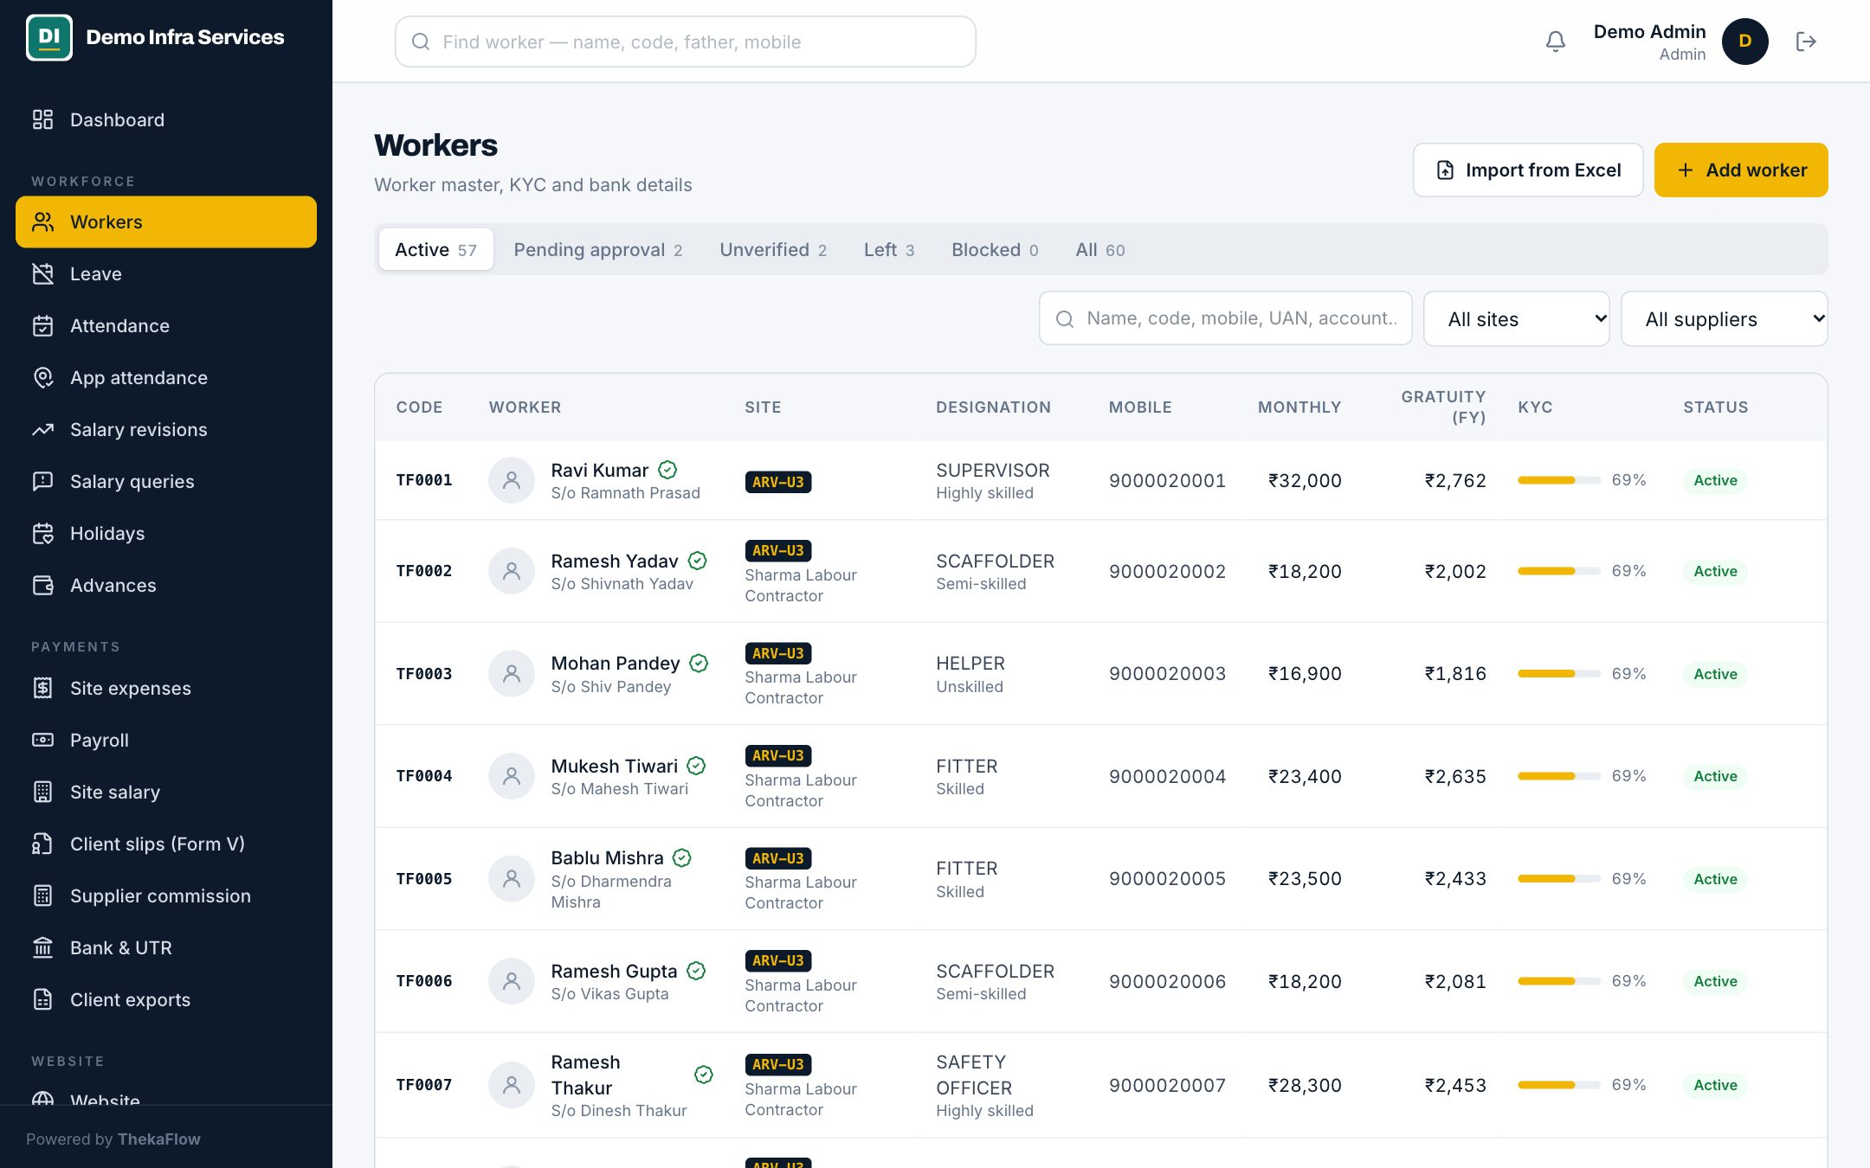
Workers and KYC
MODULE 01 · WORKFORCE
Har worker ka poora record
Aadhaar stored encrypted, shown masked
Bank check: IFSC gives bank and branch, verified tick
UAN, ESIC, family, nominee, documents, police verification
Supervisor adds a worker, Admin approves before payroll
KYC completeness and gate pass validity
Exit with Form XIII details
ThekaFlow · thekaflow.com
6
Notes:
Worker ka poora record ek jagah: Aadhaar encrypted, bank details IFSC se check, PF/ESI numbers, nominee, documents. Naya worker supervisor jodta hai, par payroll me tabhi aata hai jab Admin approve kare. Worker chhode to Form XIII ki details ke saath exit.

Slide 7
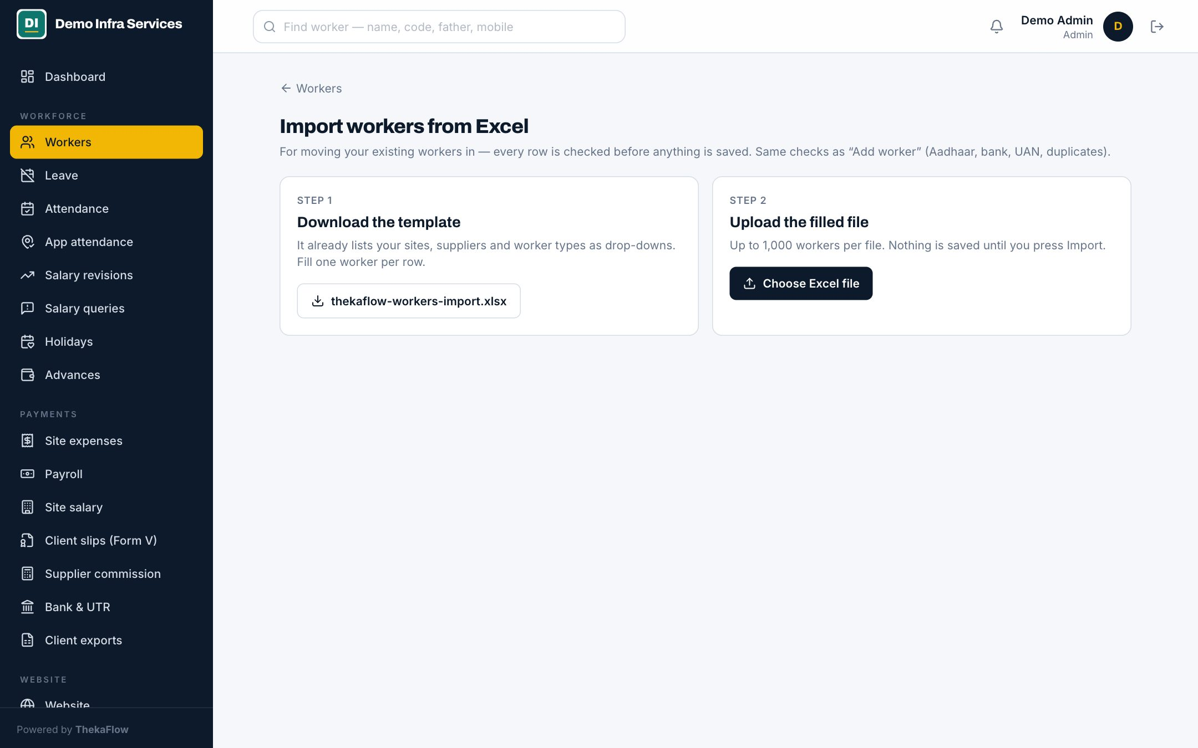
Bring your workers from Excel
MODULE 02 · WORKFORCE
Purana Excel, naya system
Our template has drop-downs and date checks in every cell
Every row is checked before anything is saved
Clear errors per row: missing fields, wrong dates, repeated Aadhaar
Good rows go in; fix the rest and upload again
Up to 1,000 workers per file
ThekaFlow · thekaflow.com
7
Notes:
Shuru karne ka sabse aasaan raasta. Hamara template bhariye ya apni Excel dijiye — hum setup me import kar dete hain. Har row pehle check hoti hai; Aadhaar dobara ho, tareekh galat ho, to wahi row batati hai. Sahi rows turant aa jaati hain.

Slide 8
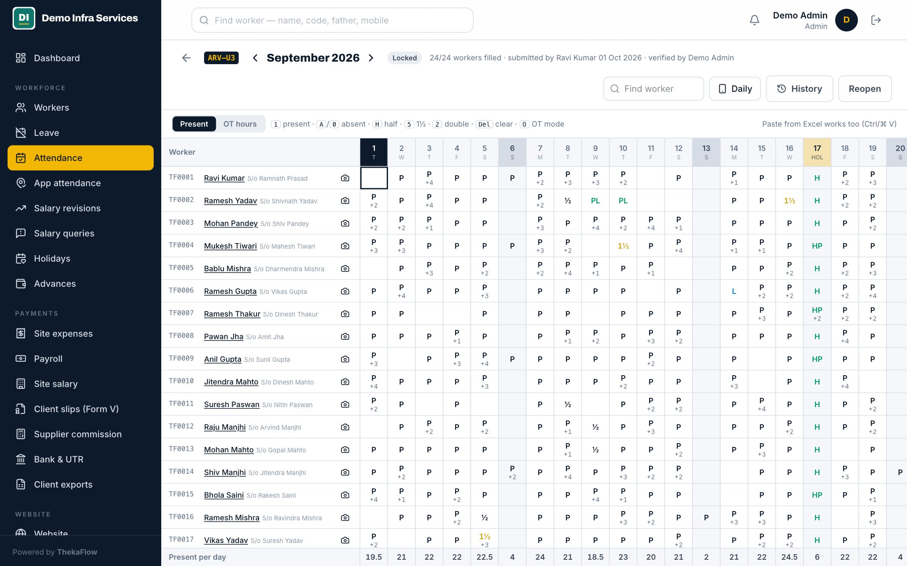
Attendance (hazri)
MODULE 03 · WORKFORCE
Sheet, app aur GPS — teeno
Site-wise monthly sheet: P, ½, 1½, 2 and OT hours
Weekly off, paid holidays with the sandwich rule
Leave requests from workers, approved in the app
Submit, verify, lock — every change kept with a reason
Daily view, worker-wise calendar, Excel summary
ThekaFlow · thekaflow.com
8
Notes:
Supervisor apni site ki sheet bharta hai — wahi register jaisa, bas screen par. Double duty, half day, OT sab. Chhutti aur weekly off apne aap lagte hain. Lock hone ke baad badlav sirf reason ke saath, aur record rehta hai.

Slide 9
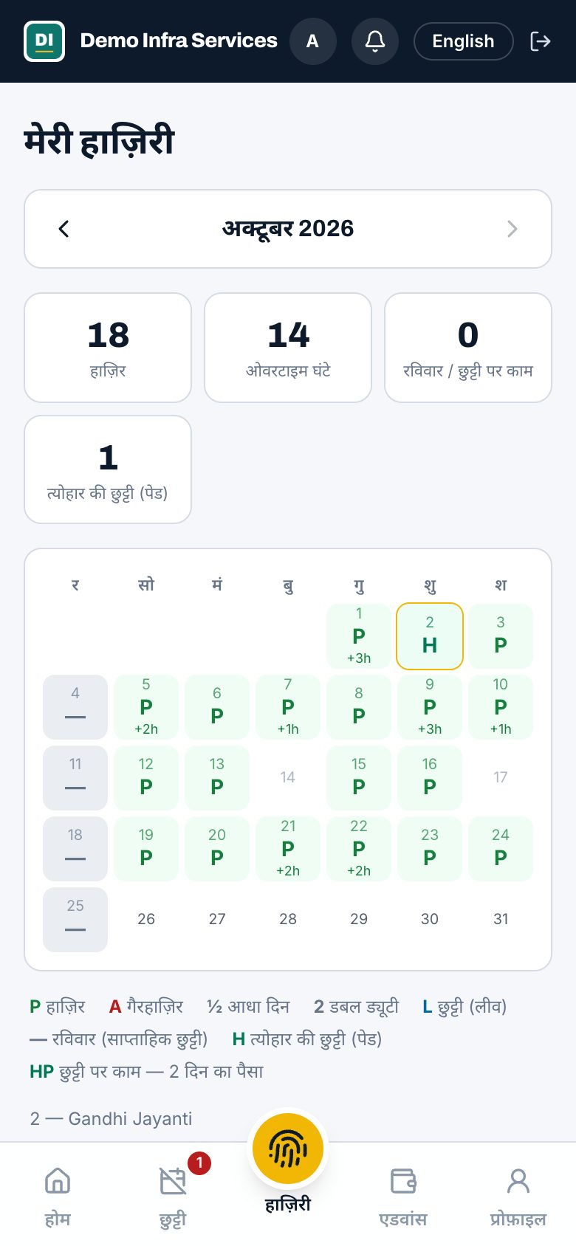
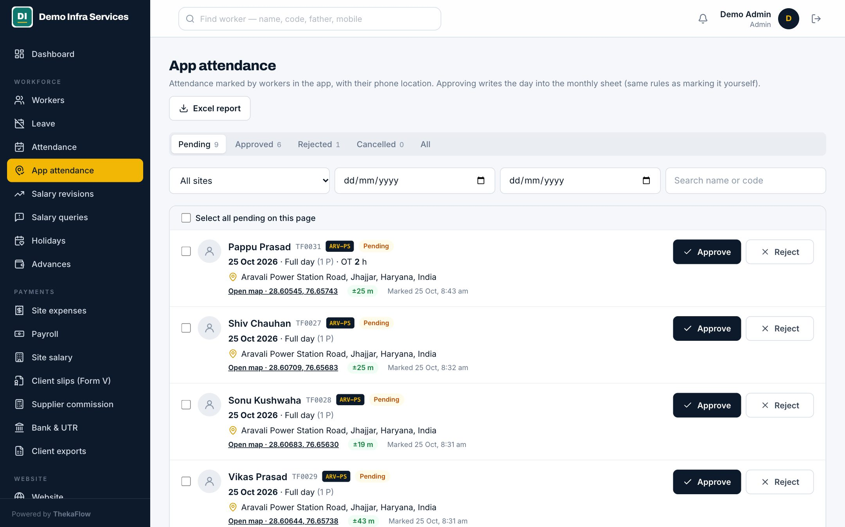
GPS attendance from the phone
MODULE 04 · WORKFORCE
Worker lagaye, supervisor maane
Worker marks attendance with the phone’s location
Supervisor approves or rejects from one list
Approved days count in the monthly sheet
No phone? The supervisor’s sheet is enough
ThekaFlow · thekaflow.com
9
Notes:
Jin workers ke paas smartphone hai, wo khud site par pahunch kar hazri laga sakte hain — location ke saath. Supervisor ek list me approve karta hai. Jinke paas phone nahi, unke liye supervisor ki sheet hi kaafi hai. Dono saath chal sakte hain.

Slide 10
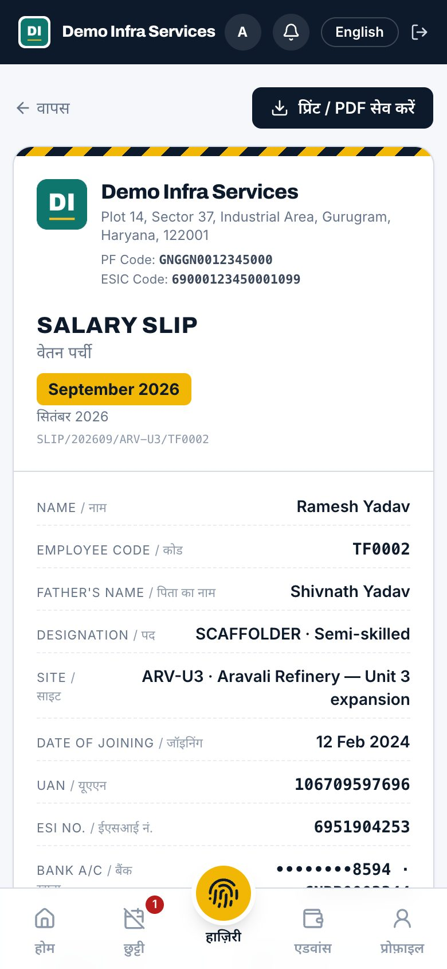
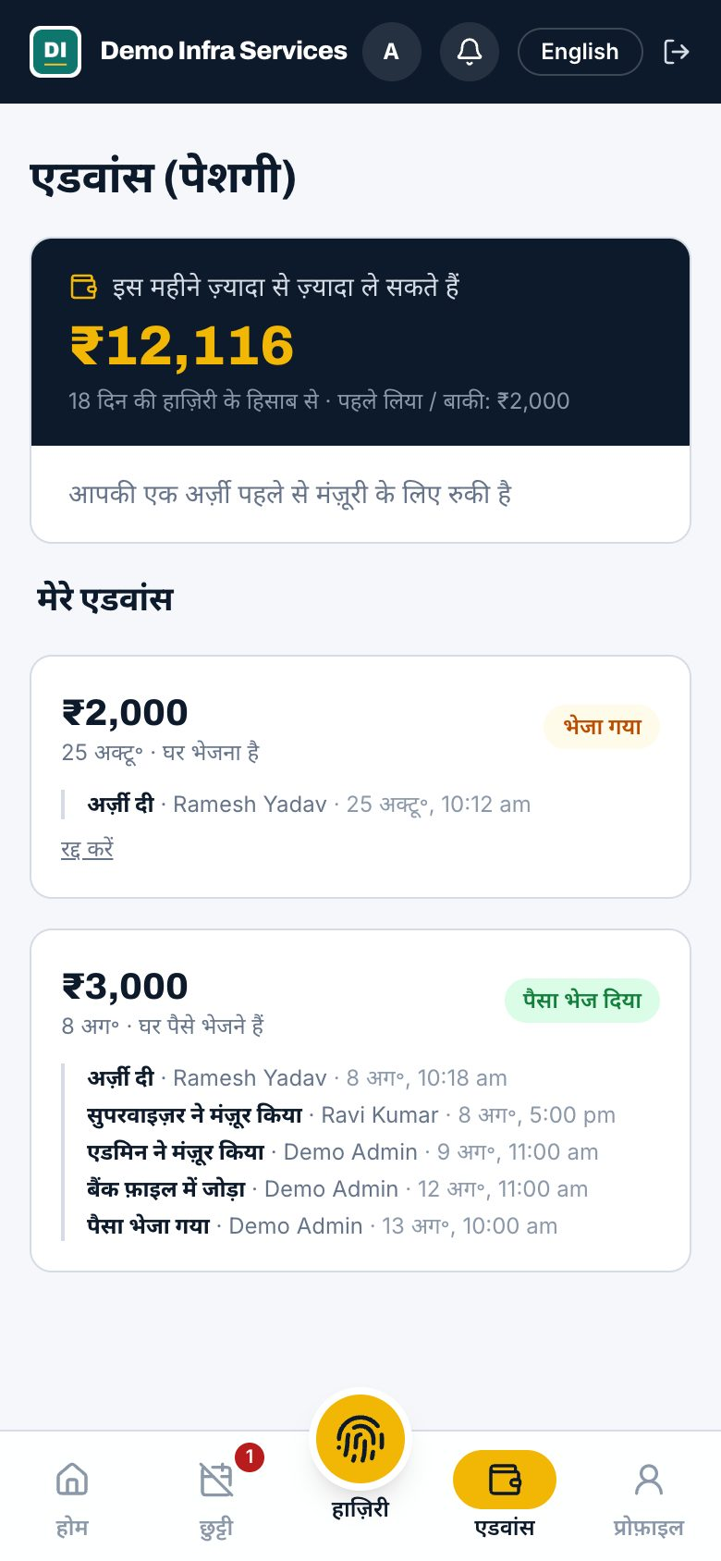
The worker’s own app, in Hindi
MODULE 05 · WORKER APP
Apni kamai, apne phone par
Login with employee code and date of birth
Earnings till today, salary slips with UTR
Ask for an advance or leave, raise a salary query
Hindi or English in one tap, large text option
Installs from the browser like an app
ThekaFlow · thekaflow.com
10
Notes:
Worker apni kamai roz dekh sakta hai, slip UTR ke saath milti hai, advance ya chhutti phone se maang sakta hai. Isse "meri salary kam aayi" wale jhagde khatam hote hain. Play Store app chahiye to Enterprise plan me aapke naam se ban jaata hai.

Slide 11
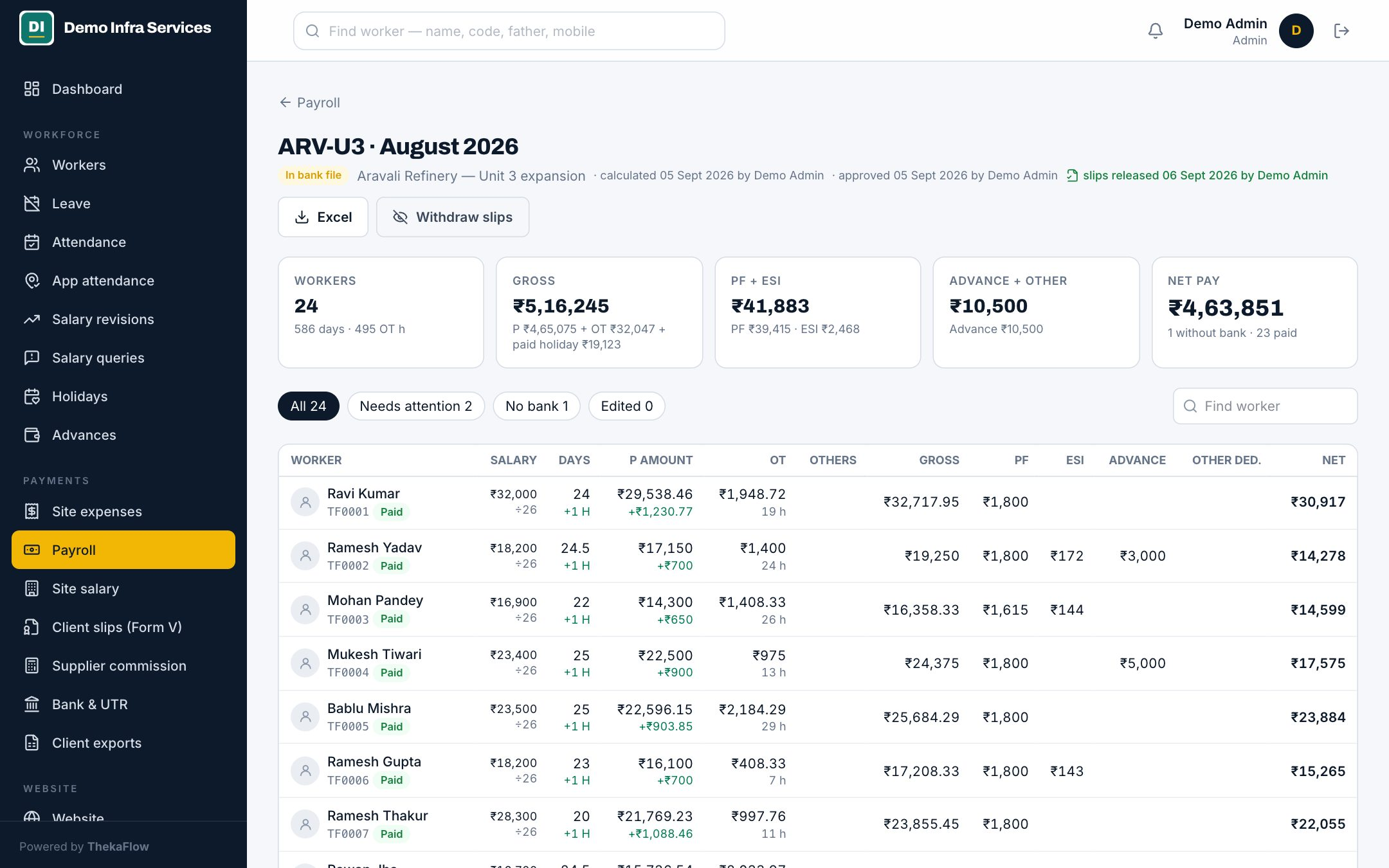
Payroll, PF / ESI and slips
MODULE 06 · PAYMENTS
Hazri se salary apne aap
Day rate from monthly salary ÷ 26, 28 or 30; OT 1X or 2X
PF 12% of Basic with the cap, deducted or on top; ESI 0.75%
Advances recovered, never more than earned
Warnings: no bank, pending approval, unpaid advance
Approve, then slips go to workers; site-wise salary view
ThekaFlow · thekaflow.com
11
Notes:
Hazri lock hote hi salary ban jaati hai: din ka rate, OT, paid leave aur holiday, PF aur ESI, advance ki katoti. Advance kabhi kamai se zyada nahi katta. Galti pakadne wali chetavniyan pehle hi dikh jaati hain. Admin approve kare, phir slips workers ke phone par.

Slide 12
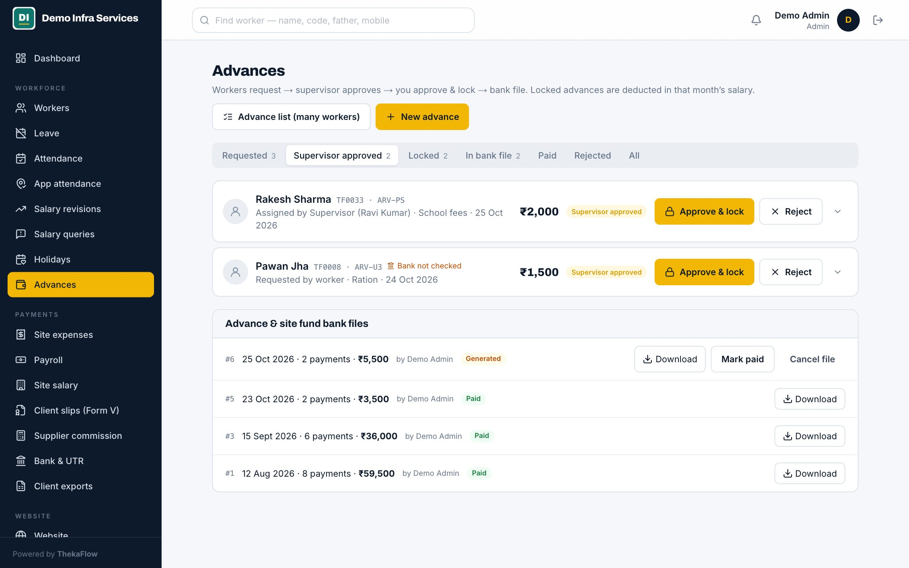
Advances with 2-level approval
MODULE 07 · PAYMENTS
Advance ka poora hisaab
Worker asks in the app, Supervisor approves, Admin locks
Limit = earned till today; above it only with a reason
Paid through the bank file, or cash from the site fund
Recovered from salary automatically
Full timeline for every advance
ThekaFlow · thekaflow.com
12
Notes:
Advance ka sabse bada jhagda: kisne kitna liya, kitna kata. Yahan har advance ka poora safar dikhta hai — maanga, supervisor ne haan kaha, Admin ne lock kiya, bank se gaya, salary se kata. Kamai se zyada advance sirf reason ke saath.

Slide 13
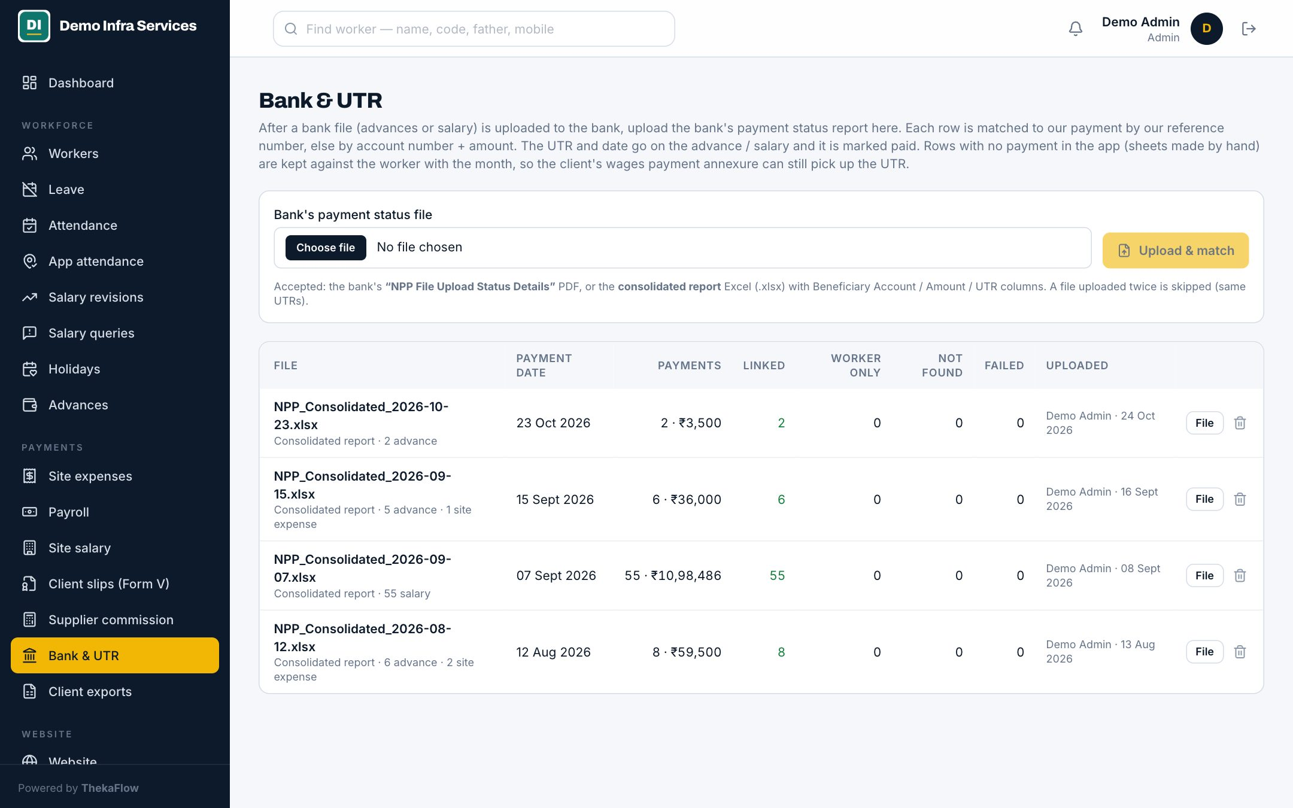
Bank file and UTR
MODULE 08 · PAYMENTS
Bank portal me haath se entry nahi
Bulk file in your bank’s format: columns and date format
Same bank as FT, other banks as NEFT or RTGS
Upload the bank’s status PDF or Excel: UTR, paid or failed
Salary and advances marked paid, workers notified
ThekaFlow · thekaflow.com
13
Notes:
Ek click me bank ki bulk file. Bank se payment ho jaane ke baad bank ki status report upload kariye — har worker ke saath UTR apne aap jud jaata hai, fail hua to wo bhi dikhta hai. Worker ko slip me UTR milta hai.

Slide 14
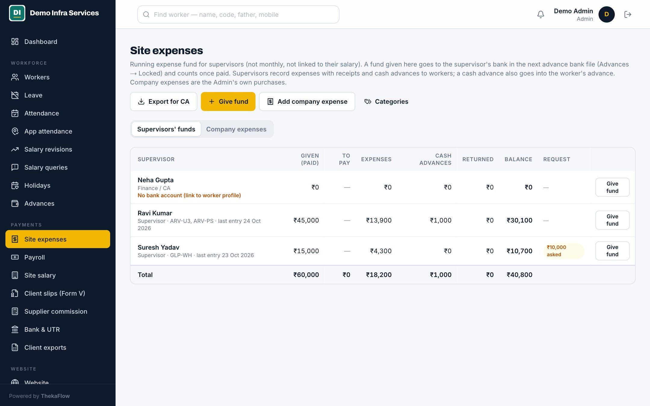
Site expense fund
MODULE 09 · PAYMENTS
Supervisor ka kharcha, bill ke saath
Fund request, Admin approves, paid by bank file
Expenses by category, with receipt and GST bill photo
Cash advances to workers, returns, live balance
Wrong entries voided, never deleted
Company expenses for the Admin
ThekaFlow · thekaflow.com
14
Notes:
Supervisor ko site par jo paisa diya jaata hai, uska poora hisaab: kitna diya, kahan kharch hua, bill ki photo, kitna bacha. Galat entry delete nahi hoti, void hoti hai — record bana rehta hai.

Slide 15
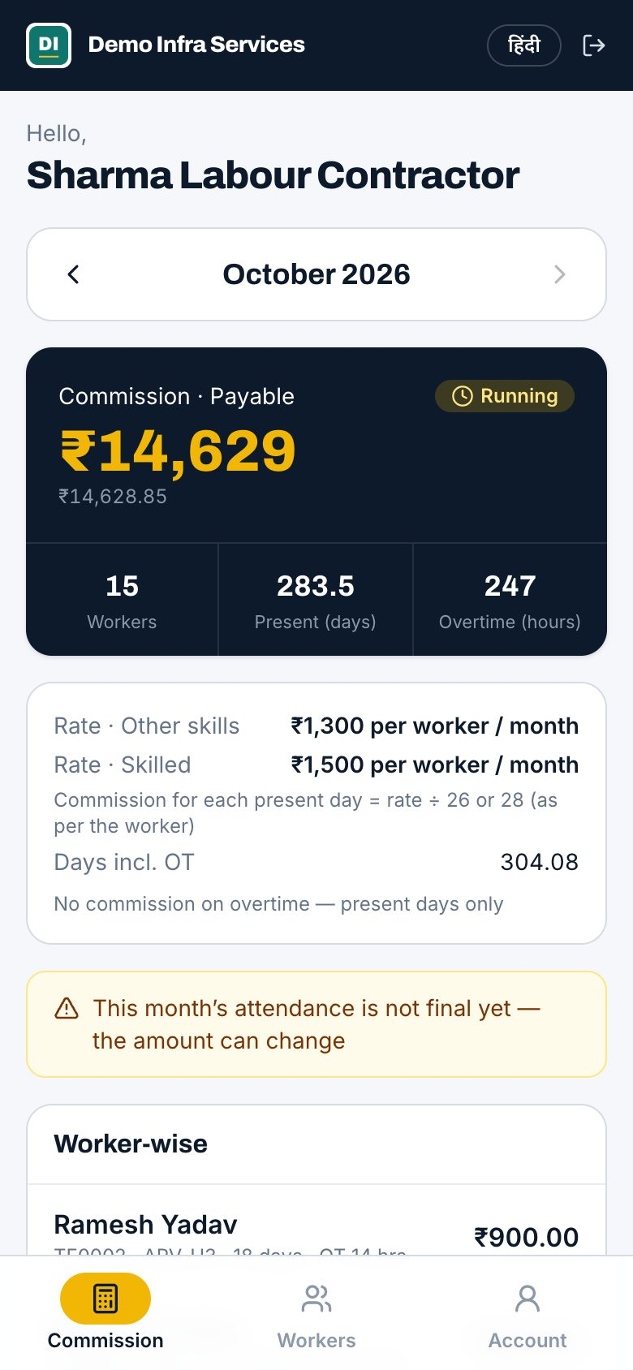
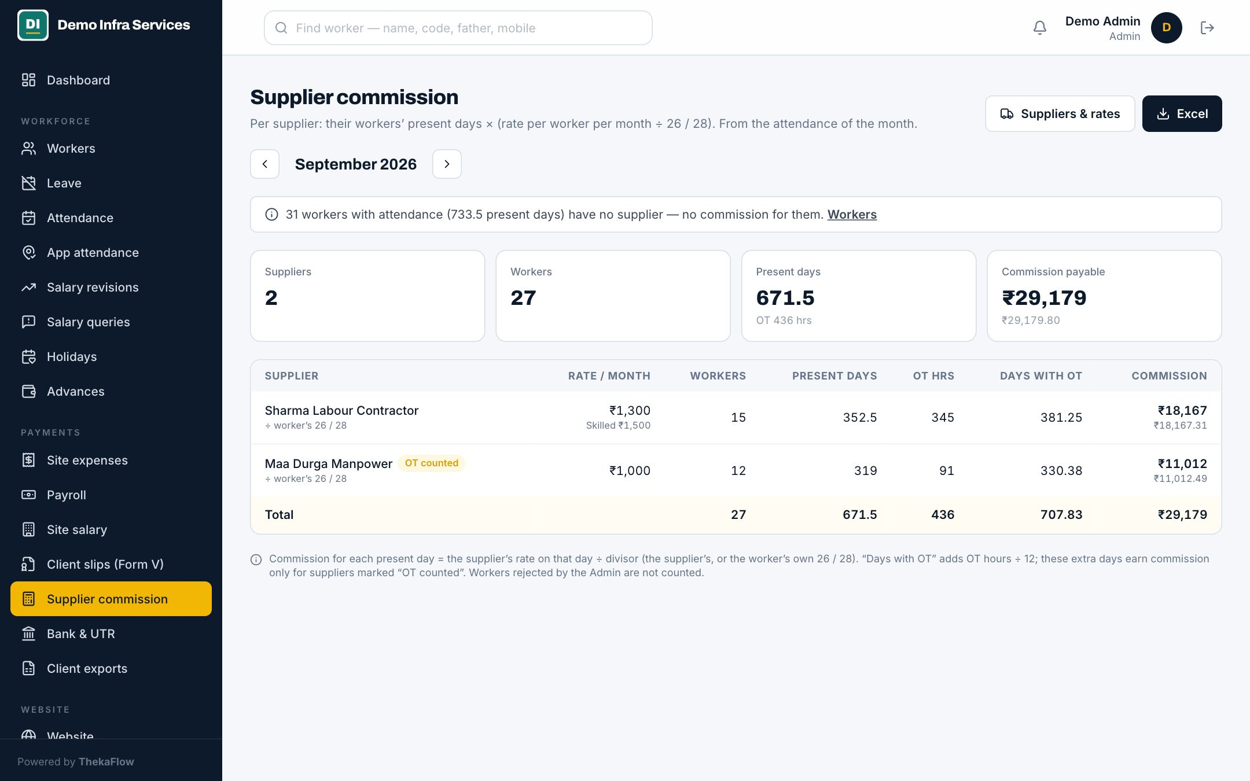
Supplier (thekedar) portal
MODULE 10 · SUPPLIERS
Thekedar apna hisaab khud dekhe
Each supplier logs in with mobile and PIN
Sees own workers, attendance and commission
Commission per worker per month, skill-wise rates
Rate history with effective dates
Workers move between suppliers on the right date
ThekaFlow · thekaflow.com
15
Notes:
Jo labour supplier (thekedar) aapko workers dete hain, unhe alag login milta hai. Wo apne workers ki hazri aur mahine ka commission khud dekh lete hain — phone par baar-baar poochhna band. Commission skill ke hisaab se, tareekh ke saath.

Slide 16
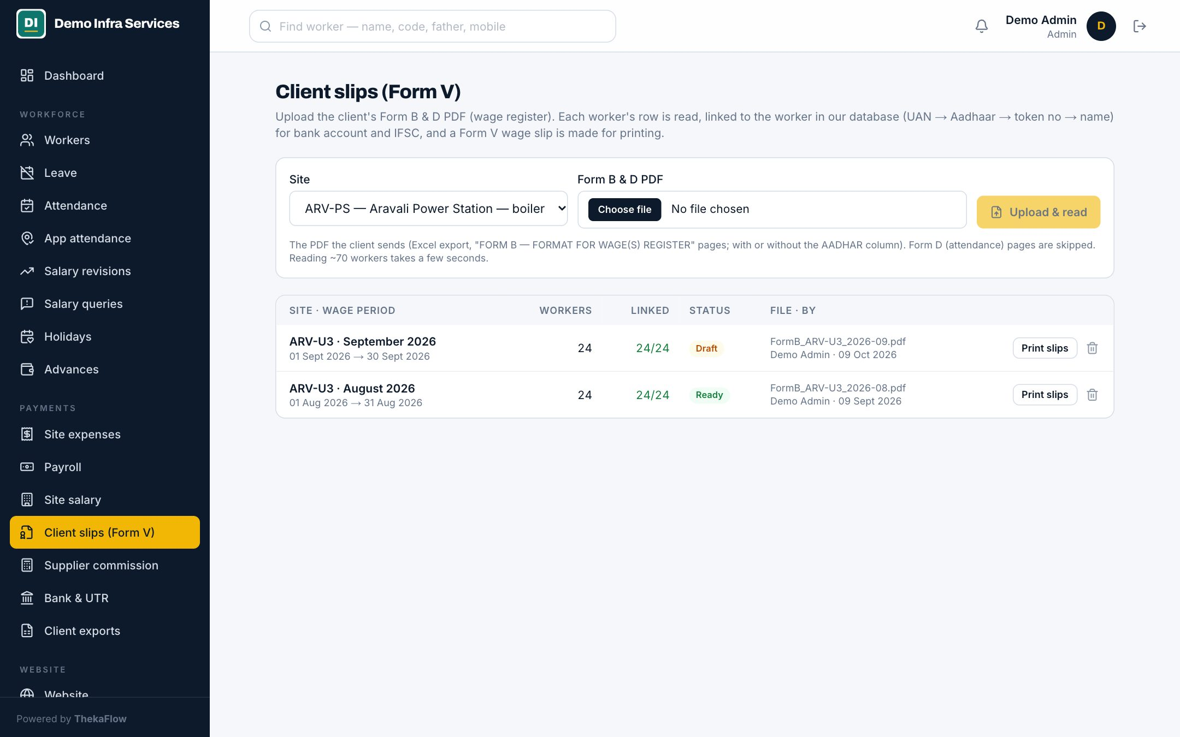
Client compliance, Form V
MODULE 11 · COMPLIANCE
Client audit me ek click
Upload the client’s Form B and D PDF, get Form V slips
Matched to workers by UAN, Aadhaar or token number
Annexure for wage payment with UTR and date
Client exports: Form B values, bonus, leave, gratuity accruals
ThekaFlow · thekaflow.com
16
Notes:
Principal employer (refinery, plant, builder) har mahine Form V aur wage payment ka saboot maangta hai. Client ki Form B PDF upload kariye, Form V slips ban jaati hain, UTR ke saath annexure bhi. Har mahine naya Excel banana band.

Slide 17
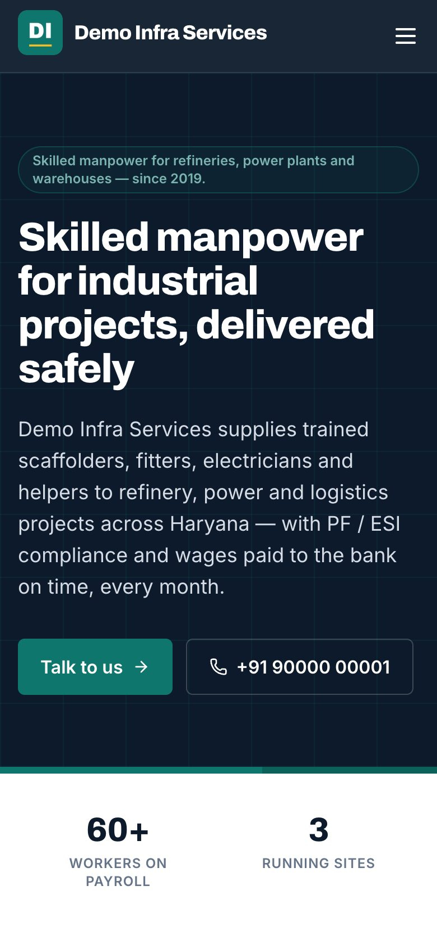
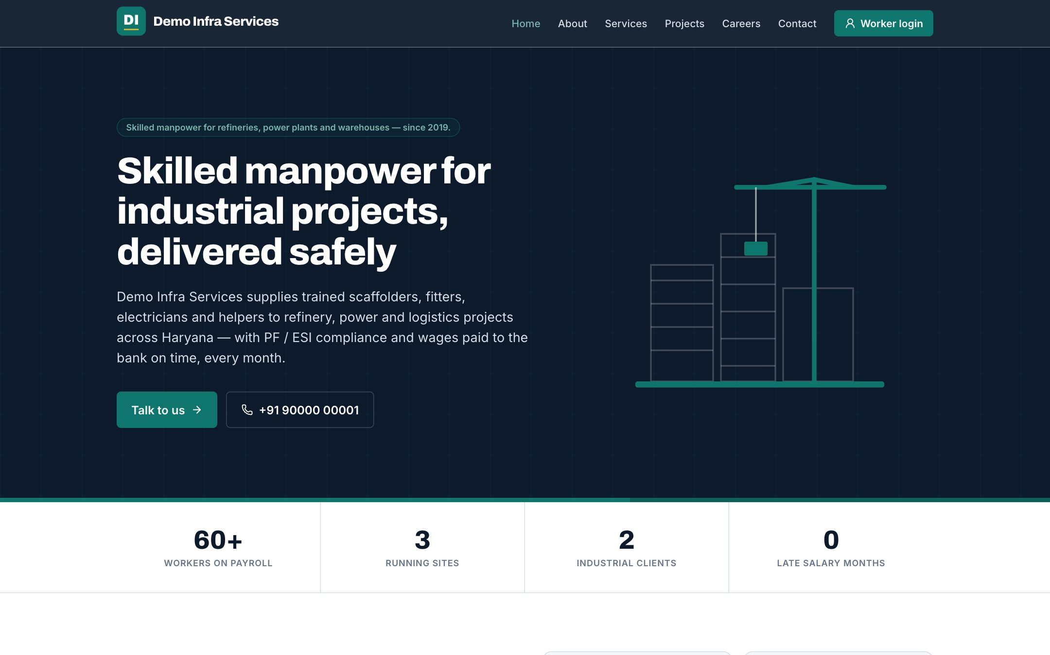
Your company website
MODULE 12 · PROFESSIONAL PLAN
Aapki apni website, app se chalti
Home, about, services, projects and clients
Careers page with your open jobs
Contact form to an enquiries inbox
Staff, worker and supplier login from your own site
Made for phones as much as for laptops
ThekaFlow · thekaflow.com
17
Notes:
Professional plan me aapki company ki poori website bhi milti hai — aapke domain par. Developer ki zaroorat nahi. Live namuna: demo.thekaflow.com (nakli company "Demo Infra Services").

Slide 18
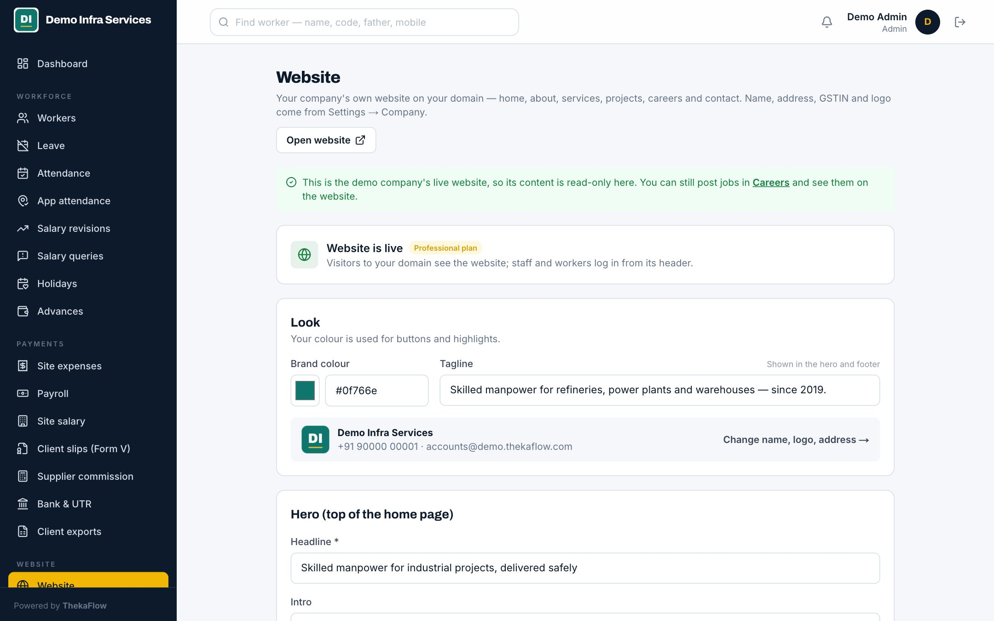
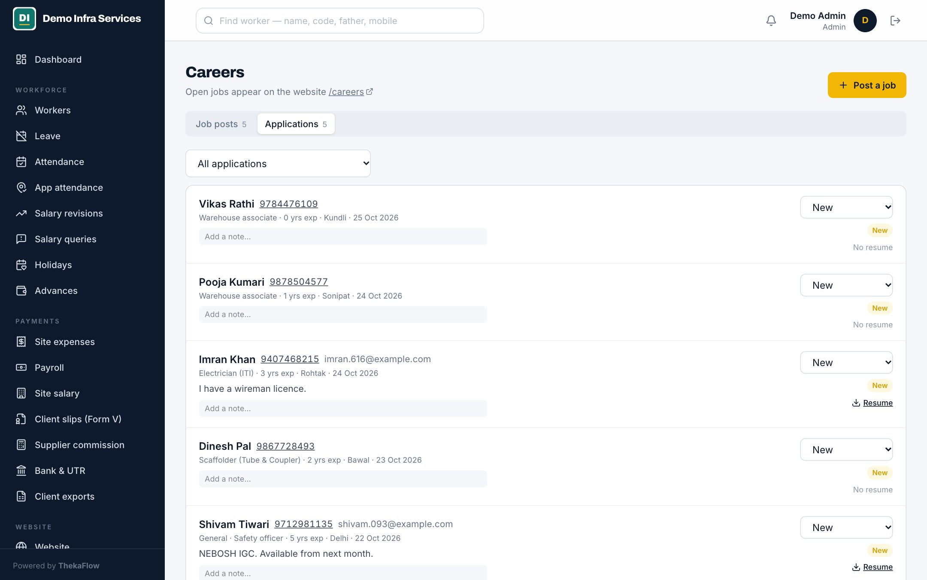
Edit the site and hire, from the app
MODULE 13 · PROFESSIONAL PLAN
Website aur bharti, dono app se
Change headline, services, projects, photos, colours
Post a job: live on your careers page in a second
Applications with resume land in the same app
New enquiries emailed to your office
Turn the site off any time; logins keep working
ThekaFlow · thekaflow.com
18
Notes:
Website ka content Admin khud badal sakta hai. Nayi bharti chahiye? Job post kariye, turant careers page par. Resume ke saath application wapas app me aati hai. Contact form ki enquiry office ke email par.

Slide 19









Also included
Chhote kaam, jo roz kaam aate hain
Leave
Holidays
Salary revisions
Worker asks in the app, office approves; paid leave counts in salary.
Paid holidays and weekly off, with the sandwich rule.
Rate changes requested, approved and dated.
Salary queries
Site salary
Clients and sites
Worker raises a query from the app; the office answers on record.
Salary cost site by site, ready for client billing.
Work order, principal employer, day divisor, OT and shift per site.
Notifications
Excel reports
Help inside the app
Approval alerts on your phone; workers told when salary is paid.
Attendance summary, advance list, wage annexure — with your logo.
Raise a support ticket and see our reply in the same place.
ThekaFlow · thekaflow.com
19
Notes:
Ye wo chhote kaam hain jo roz kaam aate hain: chhutti, holiday, rate badalna, worker ke sawaal, site-wise kharcha, notifications, Excel reports, aur app ke andar hi support.

Slide 20





Roles, audit and security
Kisne kya badla — sab record
Right people, right sites
2-step login
Audit log
Supervisors see only their own sites; permissions are set per role.
Authenticator for the Admin, a lock after wrong tries, login alerts.
Every change recorded: who, what, when — and the reason.
Aadhaar encrypted
Your own database
Daily backups
Stored encrypted with your company’s own key, shown masked.
Never mixed with another contractor’s data.
Every night and before every update; export to Excel any time.
ThekaFlow · thekaflow.com
20
Notes:
"Data safe hai?" — iska jawab. Aapki company ki alag database, Aadhaar encrypted, 2-step login, har badlav ka record, roz backup. Data aapka hai, kabhi bhi Excel me nikaal sakte hain.

Slide 21



Your name on it, not ours
Aapka domain · Aapki pahchaan · Aapka system
Aapka domain
Aapki pahchaan
Aapka system
App on payroll.yourcompany.com
Worker app installs from your address
SSL included
One DNS record, set up with you
Your logo and name on every screen
Slips, Excel reports and Form V with your details
Worker app shows your company name
Your colours across the app
Separate database for your company
Export workers, attendance, payroll any time
Roles, permissions and audit you control
No data shared with any other contractor
Own domain and colours come with the Professional plan; every plan gets yourname.thekaflow.com.
ThekaFlow · thekaflow.com
21
Notes:
Hamara sabse alag point: workers, supervisors aur aapke clients ko aapka naam dikhe, hamara nahi. Aapke domain par, aapke logo ke saath, aapki alag database me. Pehle se website hai to wo rehti hai — app payroll. jaise sub-domain par chalta hai.

Slide 22
Why ThekaFlow
Thekedar ke kaam ke liye bana, office ke liye nahi
What you need | Excel / register | Generic HR software | Small hazri apps | ThekaFlow
Site-wise hazri, OT, double duty | By hand | Office focus | Yes | Yes
Hindi worker app, GPS hazri | No | English only | Some | Yes
PF / ESI, advance recovery | By hand | Yes | Basic | Yes
Bank bulk file, UTR back | No | Some | No | Yes
Form V, client compliance | By hand | No | No | Yes
Supplier (thekedar) portal | No | No | No | Yes
Own domain, database, website | No | No | No | Yes
ThekaFlow · thekaflow.com
22
Notes:
Excel sab kuch haath se karata hai. Bade HR software office staff ke liye bane hain, English me. Chhote hazri apps sirf hazri tak. ThekaFlow thekedar ke poore mahine ke liye bana hai — bank file, UTR, Form V aur thekedar portal ke saath.

Slide 23
Plans and pricing
Free
Starter
Professional
Enterprise
₹0
₹29
₹49
₹99
Lifetime free
per worker / month
per worker / month
per worker / month
25 workers · 1 site
100 workers · 3 sites
500 workers · any sites
Up to 10,000 workers
Admin + 1 Supervisor
Workers, KYC, Excel import
Attendance, holidays, leave
yourname.thekaflow.com
Payroll, PF / ESI, slips
Worker app, GPS hazri
Advances, bank file, UTR
Admin, Supervisor, Finance
Your logo on slips
Supplier portal, commission
Form V, client exports
Site fund, custom roles
Own domain, website, careers
Phone and WhatsApp support
Custom bank, client formats
Several companies, GSTINs
Play Store app in your name
Your own server or cloud
Named manager, on-site training
Per active worker per month · GST extra · yearly invoice · each plan includes everything in the one before it.
ThekaFlow · thekaflow.com
23
Notes:
Rate sirf active workers par. Free hamesha free — 25 workers tak hazri aur records. Salary aur bank file Starter se. Jinke kai sites, thekedar aur clients hain, unke liye Professional sahi hai — Form V, supplier portal, apna domain aur website. Udaharan: 200 workers × ₹49 = ₹9,800 / mahina + GST.

Slide 24
What each plan includes
Feature | Free | Starter | Professional | Enterprise
Workers · sites | 25 · 1 | 100 · 3 | 500 · any | 10,000 · any
Workers, KYC, attendance, leave | Yes | Yes | Yes | Yes
Worker app with GPS attendance | No | Yes | Yes | Yes
Payroll, PF / ESI, slips | No | Yes | Yes | Yes
Advances, bank file, UTR | No | Yes | Yes | Yes
Site fund, salary revisions, queries | No | No | Yes | Yes
Supplier portal and commission | No | No | Yes | Yes
Form V, wage annexure, client exports | No | No | Yes | Yes
Own domain, colours, company website | No | No | Yes | Yes
Custom bank and client formats | No | No | No | Yes
Several GSTINs, own server, Play Store | No | No | No | Yes
Support | Email | Email | Phone, WhatsApp | Named manager
ThekaFlow · thekaflow.com
24
Notes:
Har plan me 2-step login, audit log aur Aadhaar encryption hai. Setup aur Excel import Starter se hamari team karti hai; Free me sirf account banta hai. Poori table thekaflow.com/pricing par.

Slide 25
Live in days, not months
Setup hum karte hain, aap sirf data dijiye
DAY 0
DAYS 1–5
DAYS 3–7
WEEK 2
MONTH 1
Demo on your process
Setup
Your data
Training
Parallel run
Company, PF / ESI codes, sites, bank format, staff and suppliers.
Workers from your Excel; KYC, bank and repeated Aadhaar checked.
Office in an hour; supervisors in Hindi; workers through them.
Once beside your old way; from month 2, ThekaFlow only.
A short screen share, in the order you work.
Already have a website? Keep it — the app goes on a sub-domain such as payroll.yourcompany.com.
ThekaFlow · thekaflow.com
25
Notes:
Shuru karna aasaan hai. Aap apni worker Excel dijiye, baaki setup hum karte hain. Pehla mahina purane tarike ke saath parallel chalayenge, taaki farq khud dikhe aur bharosa bane. Mahine ki shuruaat me start karna sabse achha.

Slide 26
Simple, fair terms
Na auto-debit, na data ka dar
Yearly GST invoice
Data never deleted
Your data is yours
Pay by bank transfer. Nothing is auto-debited from your account.
If a plan ends, your data stays read-only and exportable.
Export workers, attendance and payroll to Excel any time.
Setup by our team
Upgrade from the app
Support that answers
Company setup and Excel import included from Starter up.
Admin → Plan shows your usage and asks us to upgrade in one click.
Tickets inside the app, email; phone and WhatsApp on Professional.
ThekaFlow · thekaflow.com
26
Notes:
Saal ka invoice, bank transfer se payment. Koi auto-debit nahi. Payment ruk bhi jaye to data delete nahi hota — sirf read-only, aur Excel me nikaal sakte hain. Upgrade app ke andar se.

Slide 27
Questions we hear
Aapke sawaal, seedhe jawab
Workers don’t have smartphones?
Does it work in Hindi?
Not needed — the supervisor fills the sheet. The app is a bonus.
Worker app and supplier portal in Hindi and English; office in English.
Our CA does PF and ESI.
Which banks?
Give your CA a Finance login — every report ready, nothing retyped.
The file matches your bank’s bulk template; PDF or Excel status reports give UTRs.
Can we bring old data?
Excel already works for us.
Yes — workers, bank details and past attendance from Excel.
Run one month side by side and compare the days it takes.
ThekaFlow · thekaflow.com
27
Notes:
Ye sabse aam sawaal hain. "Mehenga hai" kahein to: ek accountant ke 3–4 din, bank entry aur galti ka paisa — setup aur training saath me. "Baad me dekhenge" kahein to: mahine ki shuruaat me start karna best hai, tareekh tay kar ke follow-up lagaiye.

Slide 28
Try it with your own month
1
2
3
Open the live demo
Send your worker Excel
Run one month side by side
demo.thekaflow.com/demo — every role, sample data.
We set up your company, sites and bank format.
Compare, then decide.
info@thekaflow.com · [Phone / WhatsApp] · thekaflow.com
Notes:
Aakhri baat: aaj hi demo kholiye, apni worker Excel bhejiye, aur agle mahine ki salary ThekaFlow se banaiye — purane tarike ke saath. Follow-up ki tareekh yahin tay kar lijiye. [Phone / WhatsApp] ki jagah apna number daalein.

